Slide 1
AI and ML and Data! Oh My!
Supporting Teachers’ and Learners’ Work by Considering the Human Sides of Data Science
Joshua M. Rosenberg, Ph.D.
Department of Theory and Practice in Teacher Education
University of Tennessee, Knoxville
Presentation at the LEAD Graduate School and Research Network Retreat 2022-04-27
Slides: https://tiny.utk.edu/lead-retreat
Notes:
Hello everyone, my talk is is on Considering the Human Sides of Data Science. My name is Joshua Rosenberg and I am an Assistant Professor of STEM Education at the University of Tennessee, Knoxville, in the United States. I’m honored to be here and am thankful for the chance to develop and share the ideas in this talk.

Slide 2
A Story
Notes:
Let me start with a story.

Slide 3
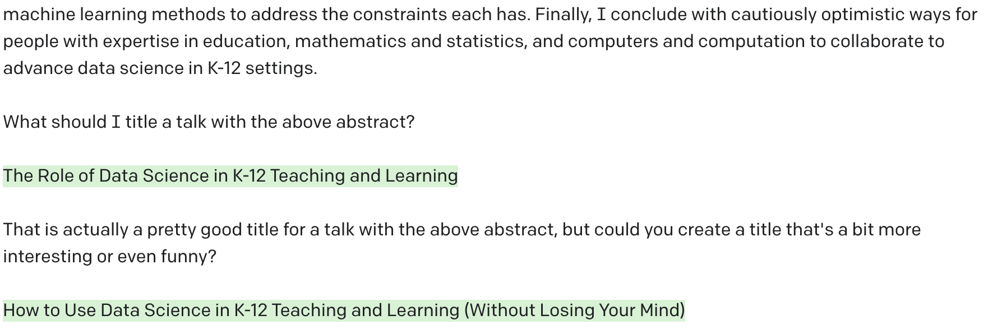
How I was planning to start this talk
A story
Notes:
I was going to start my talk by sharing a chat between myself and an artificial intelligence tool. More on what I mean by artificial intelligence soon. For now, know that this is a “generator”, a language model that generates text. It is called GPT-3 and is available to use for free though a company called open AI. I entered an abstract for this talk, part of which is shown above. Then I asked the first question you see. What should I title a talk with the above abstract?
The resulting title, which on Open AI’s website is the text that is highlighted green, was pretty good, but I asked a follow up. Could you create a title that’s a bit more interesting or even funny?

Slide 4
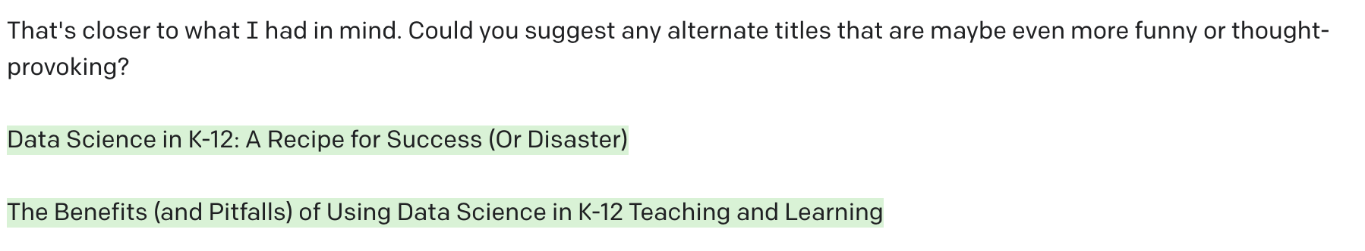
How I was planning to start this talk
A story

Slide 5
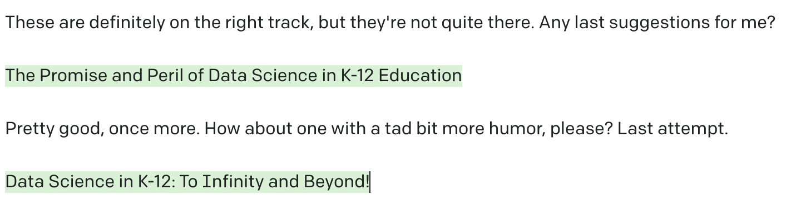
How I was planning to start this talk
A story
Notes:
I wanted to see whether we could get to something a bit better.
Here, I stopped.

Slide 6
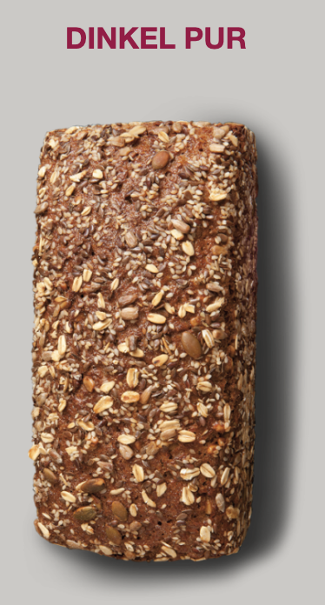
That was missing something I wanted to say
A story
Before coming, I was a bit anxious!
A recent event made me a bit more confident:
At a bakery, I ordered Dinkel Pur in German
Having family with me helped
But, I have much more to learn - I am humble
Notes:
I realized that this wasn’t a great way to title a talk—or to start off a talk about the wonders of AI. It was missing a bit about me—how I am coming to this topic. A recent event helped.
I was a bit anxious coming here. COVID, travel with a young child, a retreat filled with leading scholars hosted by a leading university. Also, my German is not good; I am always in awe of Germans who speak English as fluently as I do.
You should know I’m a bit of a hippie at heart. When I see the word “natural” on a menu, I am inclined to ordering it. On the way here, I saw a bakery, and I saw the kind of bread that makes my heart sing. Furthermore, it had what seemed to be the word “pure” in its name. What I am looking for!
I ordered it in German, and the baker was charming. My cousin helped, and I realized after how much more I have to learn, but it was an affirming experience.
So, I want to say; guten morgen. Ich bin Joshua Rosenberg. I have a lot more to learn about many things, including German language, and this humility carries through this talk.

Slide 7
A little goes a long way
A story
A key punchline from this talk is that having some familiarity with AI, ML, and data science can go a long way
Drawing on our other knowledge, capabilities, and values is also needed
Notes:
So, how does this relate to AI, ML, and data? A key punching of this talk ist hat learning a bit, trying to explore these ideas and tools even when we might not want to, can go a long way toward shaping our work and the work of others. Also, drawing on other things as humans is also necessary.

Slide 8
A brief aside
A story
Many of you are already involved with these:
Katharina Fleig: NLP-based learner assessment for feedback generation
Lisa Minich: The Devolopment of a Teacher Dashboard for the FeedBook System
Plus working groups on Artificial Intelligence in Education (Xiaobin Chen) and analyzing log file data (Ines Pieronczyk)
Notes:
I know that many are already involved with these. For example:

Slide 9
But first
A story
On a scale of 1-10 (please use the digits on your hands), how confident are you in your knowledge and capabilities regarding:
Mathematics?
Science?
Statistics?
Programming?
Education:
Educational research?
Educational systems?
Notes:
But first, let me try to establish how and why humility can have purchase. I’ll say more on why in a moment, but for now I want to mention that definitions of data science often involve elements like those on this slide. On a scale of 1-10 using your digits, how confident are you in your knowledge of mathematics?

Slide 10
Defining some terms
A story
By using the term, Artificial Intelligence (AI), I refer to simulating human intelligence through the use of computers
By, Machine Learning (ML), I am referring to a subset of AI focused on how computers acquire new information/knowledge
By Data Science, I am describing analytic approaches that involve statistics and computers/computation
Notes:
Let me define some key terms.

Slide 11
Where is this work taking place?
A story
The Learning Analytics (LA) community focuses primarily but not only on data from learning management systems, especially in higher education settings (Wise, 2019)
The Educational Data Mining (EDM) community focuses primarily but not only on data from educational technology tools, often through a highly technical lens (Baker and Inventado, 2016)
Scholarship often cuts across these fast-developing fields (e.g., Baker & Inventado, 2016; Baker & Siemens, 2012; Fischer et al. 2020)

Slide 12
Where is this work taking place?
A story
The community exploring data science in education has two foci:
Educational Data Science (EDS), focusing on using data science tools to support research (McFarland et al., 2021)
“. . . it is an umbrella for a fleet of new computational techniques being used to identify new forms of data, measures, descriptives, predictions, and experiments in education.” (McFarland et al. (2021)
Data Science Education (DSE), exploring data science as a context for learning (Wilkerson & Polman, 2019)
Notes:
I’ve deliberately used the term data science in education to be able to delineate two ways data science has been used in education.

Slide 13
Some logistics
Notes:
Before formally stating the thesis of this talk, I want to discuss a few logistics.

Slide 14
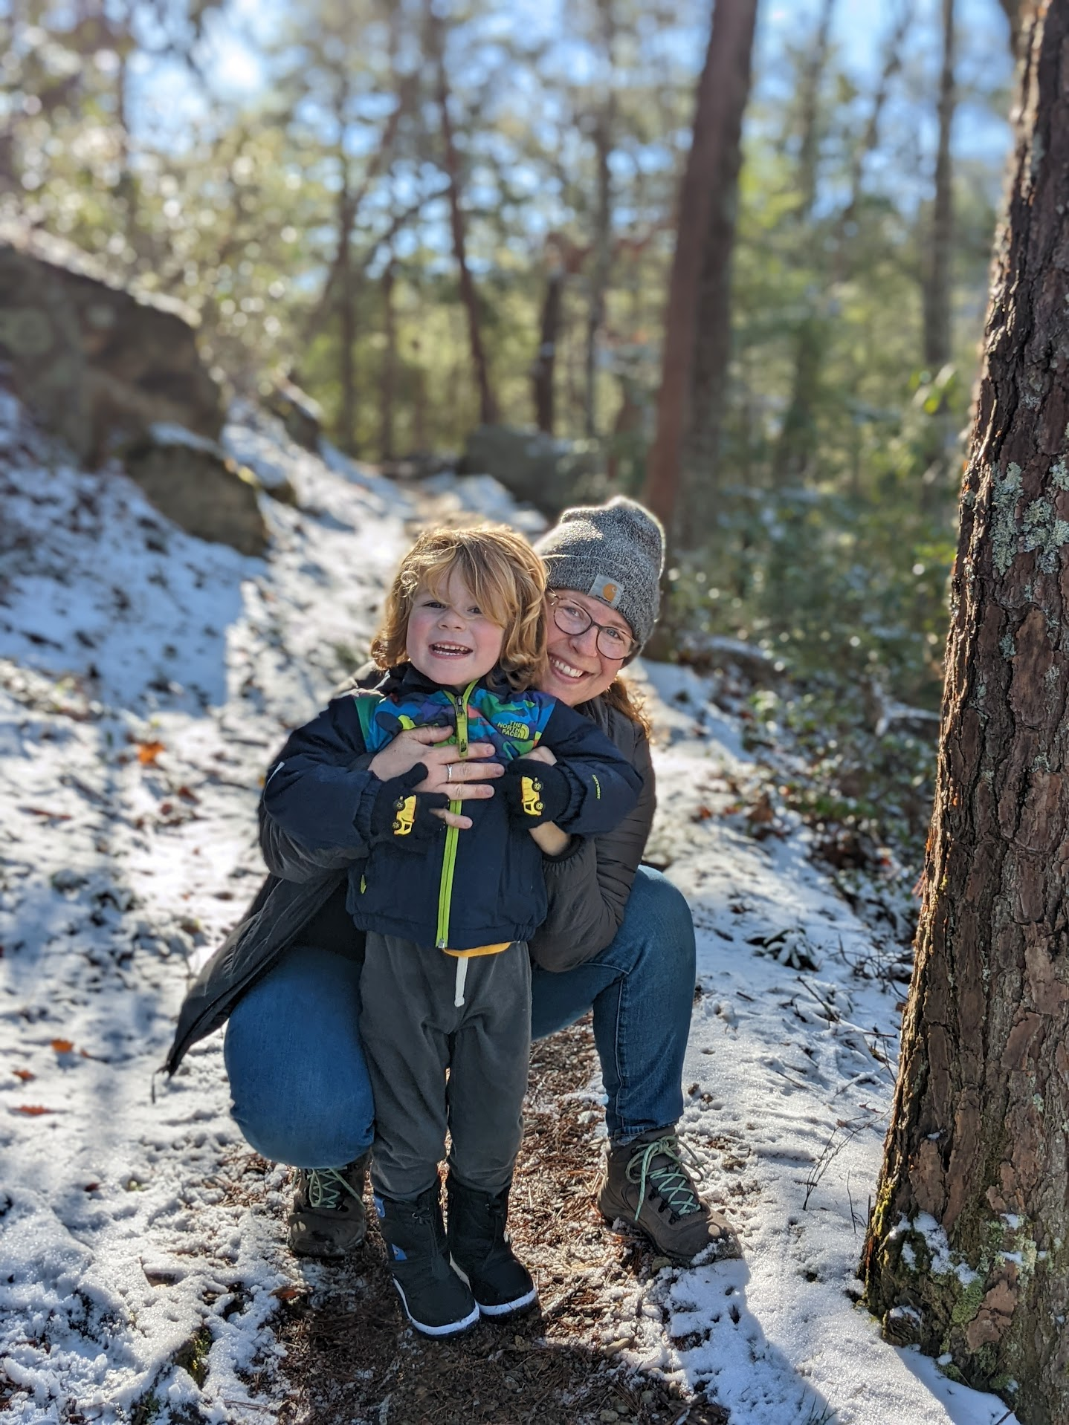

A bit about me
Some logistics
Notes:
I am a dad and a husband. I love the outdoors. These two pictures are from two places that are special to me. I was reminded of both on the drive here. Big South Fork and the Smokies

Slide 15
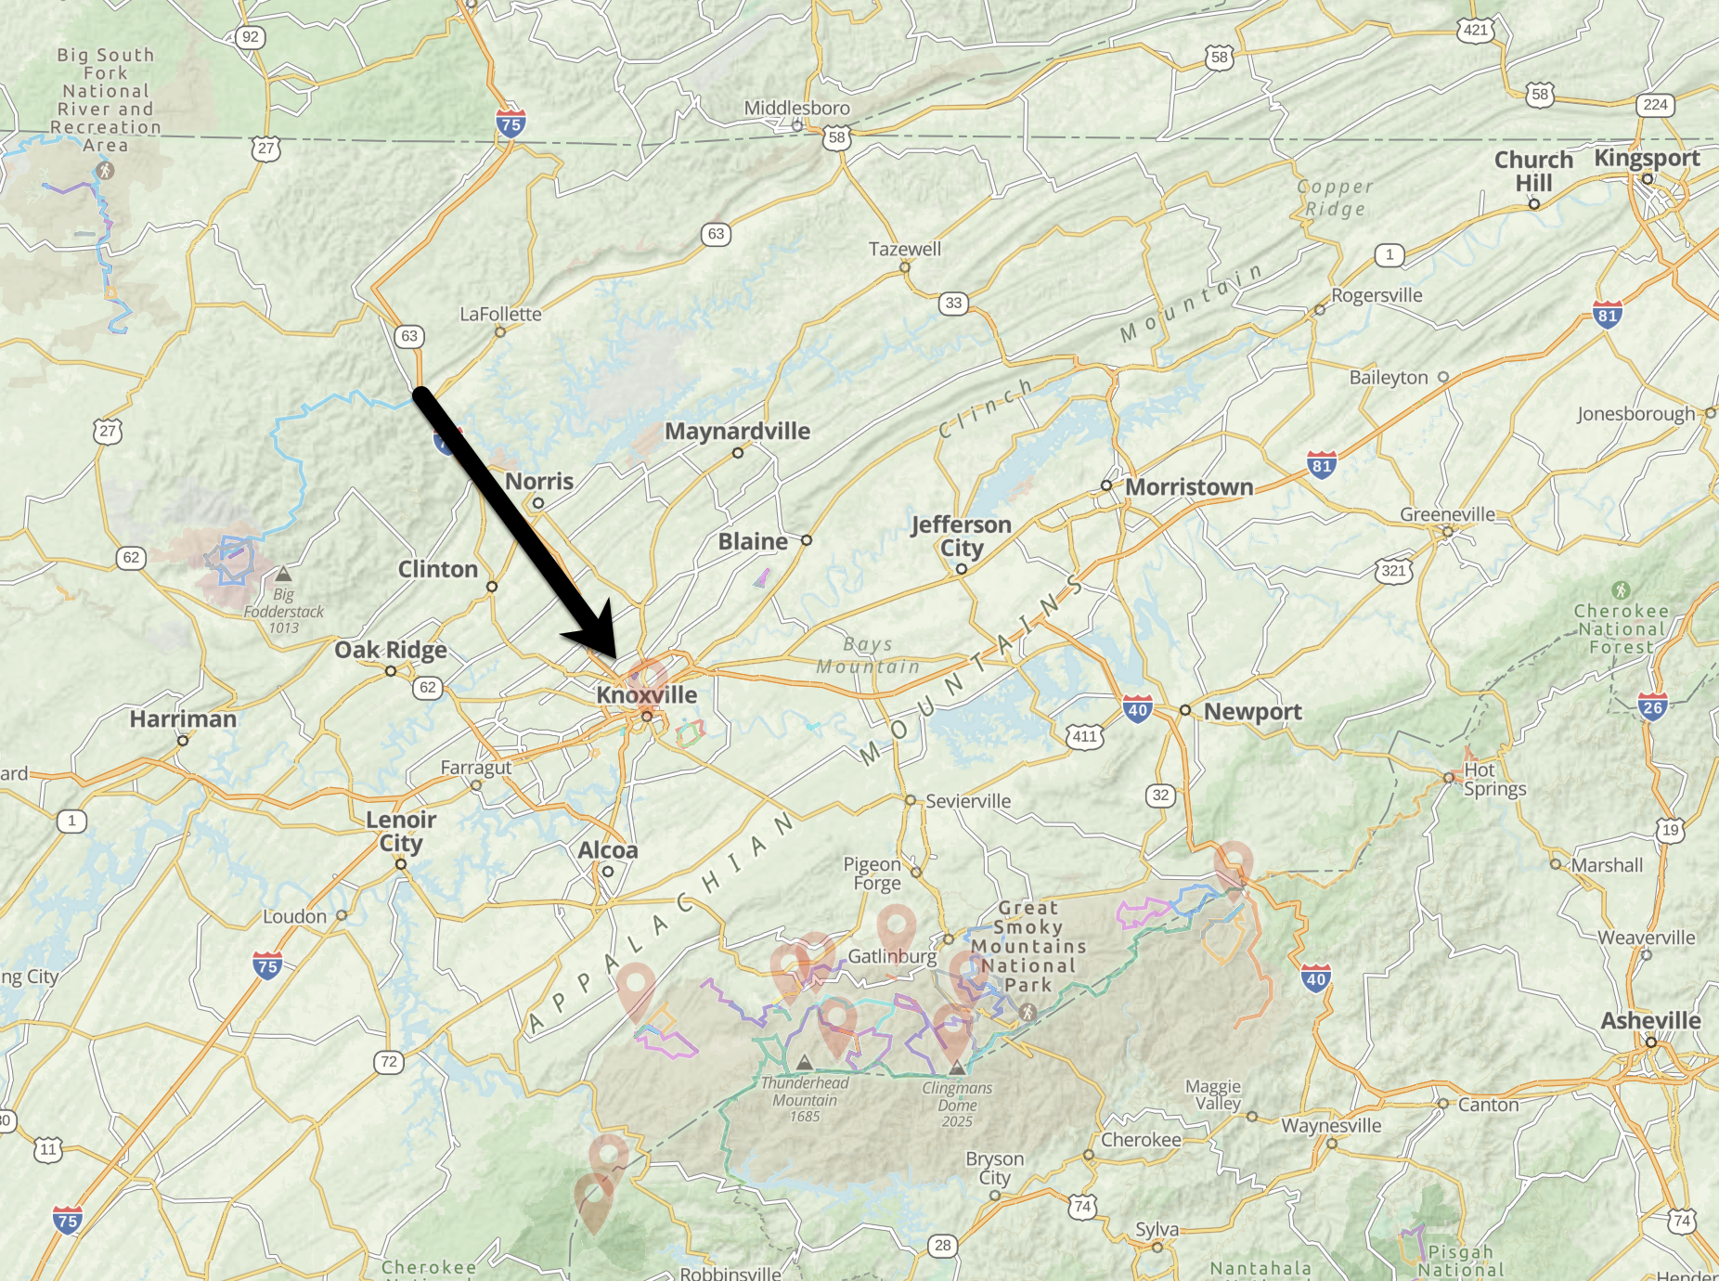
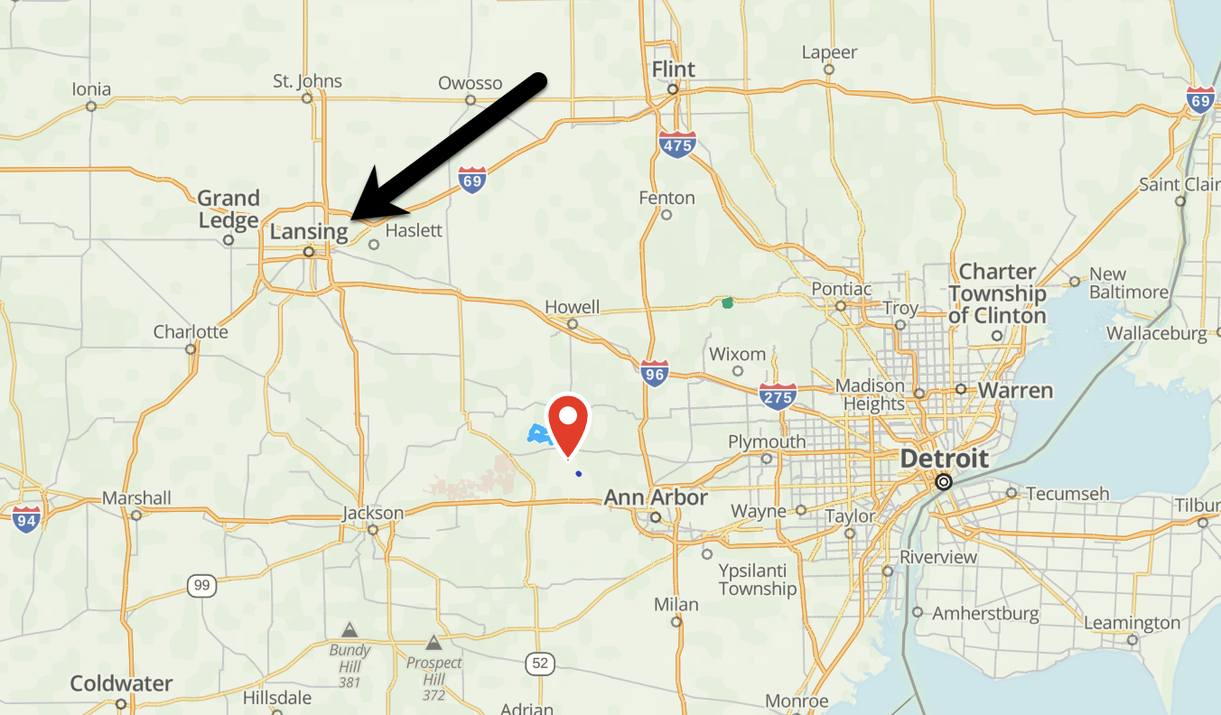
A bit about from where I come
Some logistics
Notes:
I am from Michigan and Knoxville, TN.

Slide 16
A bit more about me
Some logistics
Topically, I study teaching, learning, and educational systems
I focus on science education and data science in education, but I also explore STEM disciplines
I do so using a range of methods, but my strengths are in computation-rich approaches
Notes:
My research is broadly focused on teaching, learning and educational systems. I study science education, but also other science, technology, engineering, and mathematics disciplines. I use a range of methods to do so.

Slide 17
And how I became interested in these topics
Some logistics
2011: Saw high school students become proud of a graph they created
2014: Learned R in a class on multi-level modeling
2015: Was exposed to educational research on students’ data modeling
2015-Present: Engaged in cycles of learning, applying, and learning more around the topic of data science in education
Notes:
I’ve been interested in these topics for some time.

Slide 18
Goals for today
Some logistics
Articulate a thesis about the nature of data science in education
Describe some prior research (mine and others’) that speaks to this thesis
Work toward a model of how humans can use machines for research in a cooperative mode
Notes:
Here are the three goals for this tak.

Slide 19
Thesis

Slide 20
The potential of data science
Thesis
“ . . .the digital age is having a profound impact on statistics and the nature of data analysis, and these changes necessitate reevaluation of the training and education practices in statistics.
“In particular, computing is an increasingly important and necessary aspect of a statistician’s work, and needs to be incorporated more fully into statistics training.”
Nolan and Temple Lang (2012), The American Statistician
See also: Bargagliotti et al. (2021), Hardin et al. (2015), Hardin et al. (2021), LaMar & Boaler (2021), Lee & Campbell (2020), Rosenberg et al. (2020), Wilkerson & Polman (2018)
Notes:
First, I want to mention that there have been discussions about the potential of data science for some time.

Slide 21
Others have expressed some caution
Thesis
Is data science education really that different from statistics education? (Rubin, 2019)
How should we think about the factors influencing how students engage with data? (Lee et al., 2021)
Who benefits from abundant data and computing power? (D’Ignazio & Klein, 2020)
Notes:
There have also been some notable concerns.

Slide 22
An initial attempt at a thesis
Thesis
Educational data science has a role in education, but how we do this work matters in terms of impact sustainability over time
But, I want to use this retreat to rethink this work and progress toward a model of what this “how” can look like
Notes:
The thesis for this talk is as follows. But, I want to use this talk and this retreat to work through and make progress toward some more details about how this can be.

Slide 23
Why does this matter?
Thesis
To step back from this thesis, I hope working toward this model can inform the work of the LEAD Graduate School and Research Network (and this retreat)
I also hope to complement the talks of other scholars—external and members of the network
Notes:
I hope this is helpful to the LEAD graduate school and network and complementary to the talks of others.

Slide 24
Prior Research
Notes:
- How I've worked toward this goal, sometimes tacitly
- Generality and ML work
- How it started: text data
- How it's going: audio and video data
- Bayesian methods
- How it started: ESM data
- How it's going: Teaching learners about Bayes
- ML and AI education
- How it started: prediction models
- How it's going: Shiyan and others (BJET paper)
- Data science and justice
- How it started: rubel & phillips
- How it's going: kahn, ISLS session
- Science education twitter
- How it started: #NGSSchat SNA and sentiment analysis
- How it's going: privacy

Slide 25
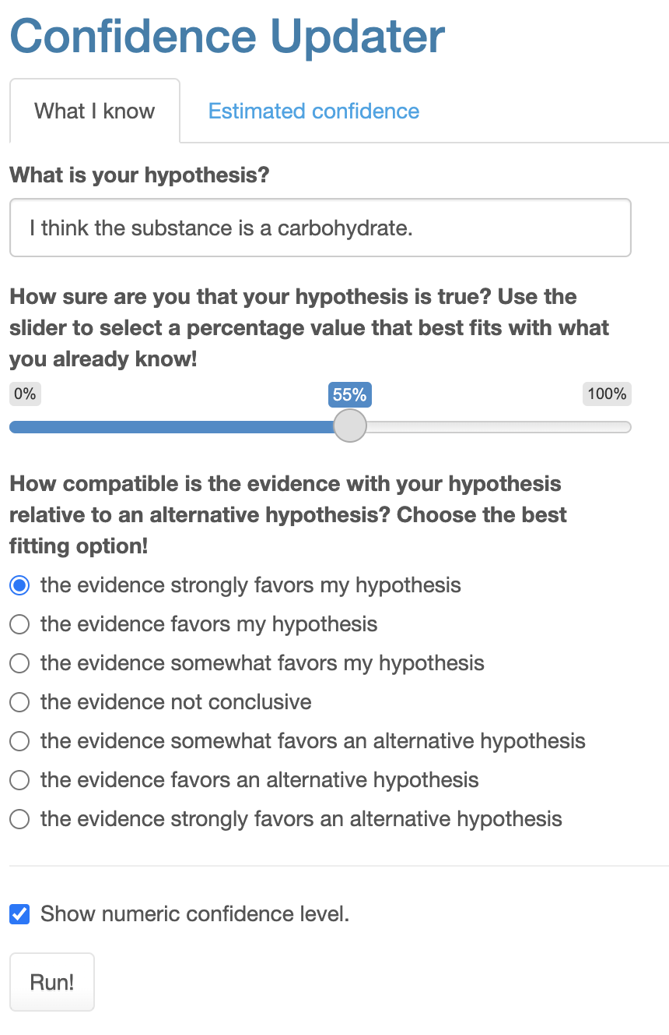
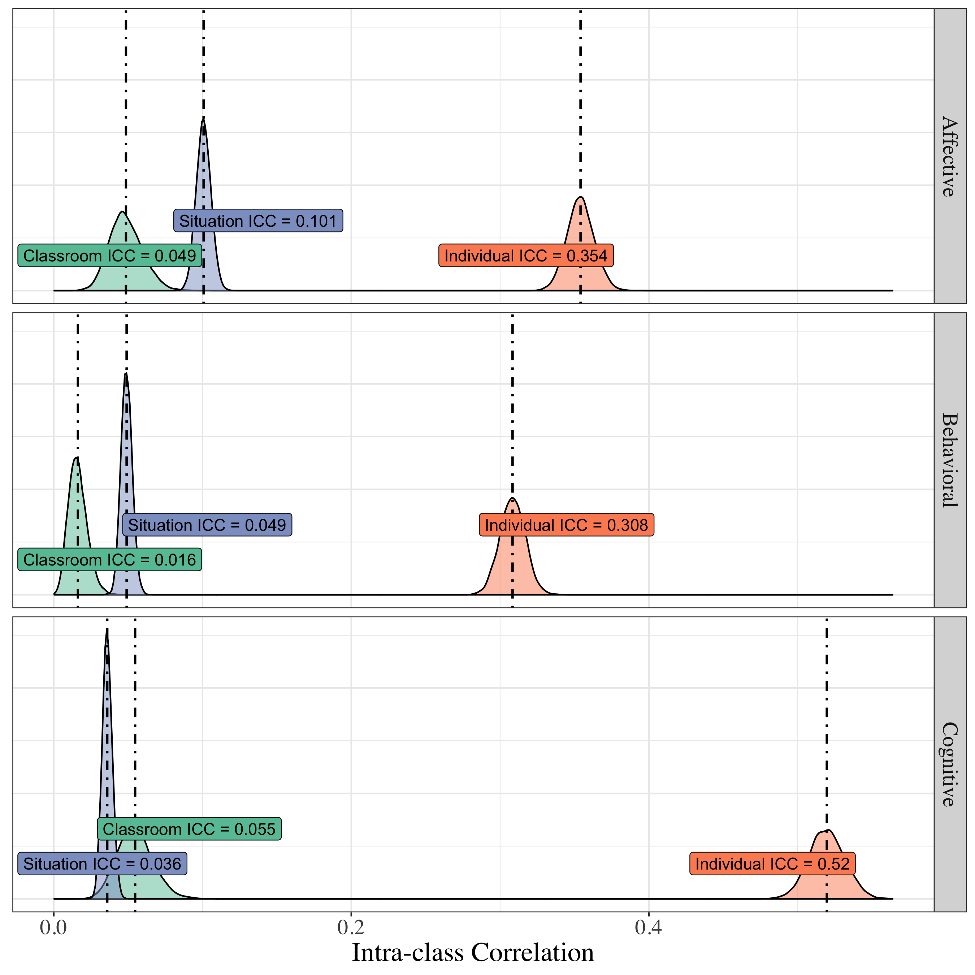
Supporting learners’ to use Bayesian methods
Prior research
Rosenberg et al. (2020), How does situational engagement vary between learners, situations, and classrooms? (NSF-supported; see: https://github.com/picsul/short-message-survey)
Rosenberg et al. (2022), Making Sense of Uncertainty in the Science Classroom: A Bayesian Approach
Notes:
I used experience sampling method research during my doctoral program.

Slide 26
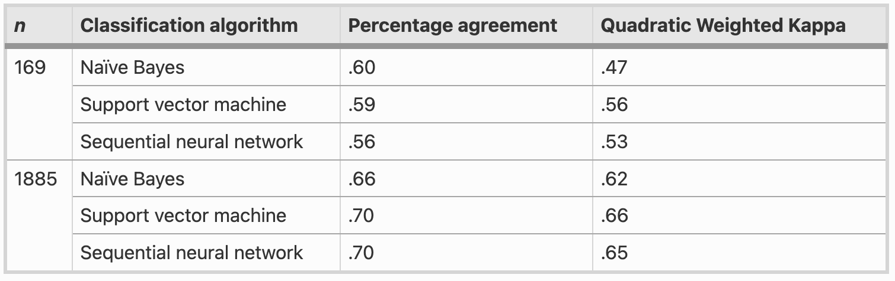
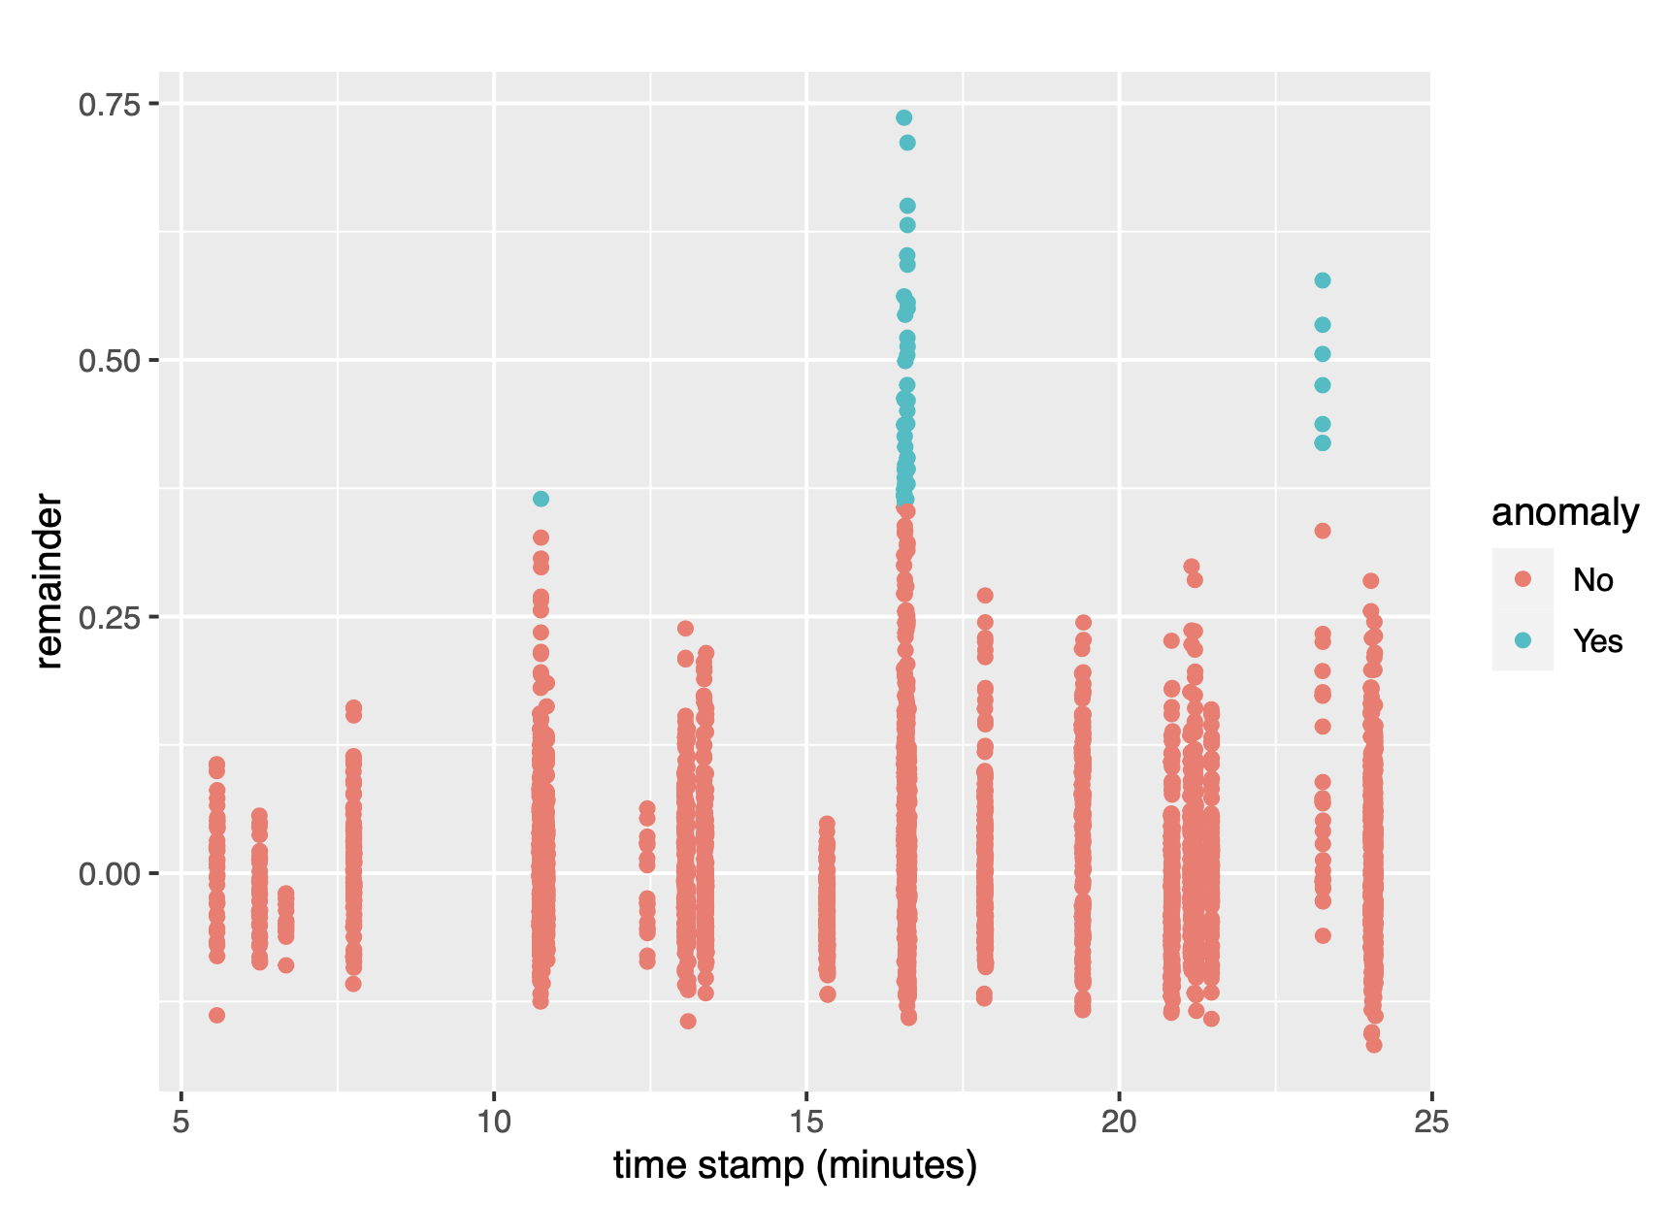
Combining qualitative and machine learning methods
Prior research
Rosenberg & Krist (2021), Combining Machine Learning and Qualitative Methods to Elaborate Students’ Ideas About the Generality of their Model-Based Explanations
https://faast.shinyapps.io/generality-shiny/
Theory-based Computational Analysis of Classroom Audiovisual Data (NSF-supported)
Notes:
This work began with a text analysis project.

Slide 27
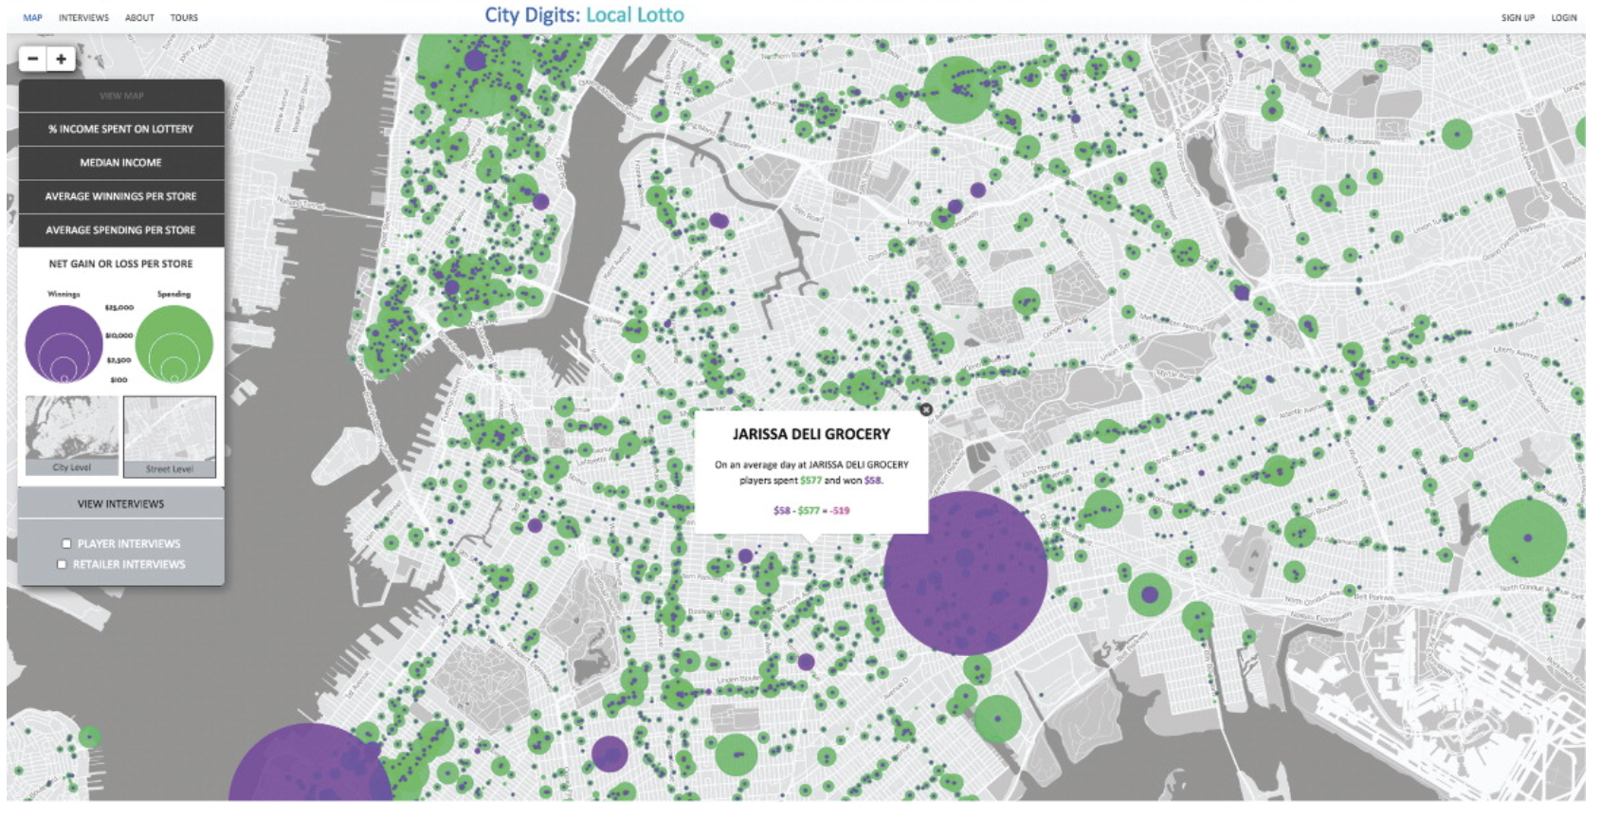
Exploring justice through data science
Prior research
“And notice it’s ranked number one in certain areas, right. Uh, ok and let’s look—so it’s orange around Inglewood and here this area between Compton and Carson.”
Philip et al. (2016), Becoming Racially Literate About Data and Data-Literate About Race: Data Visualizations in the Classroom as a Site of Racial-Ideological Micro-Contestations
Rubel et al. (2016), Teaching Mathematics for Spatial Justice: An Investigation of the Lottery
Notes:
Work has highlighted how data relates to society-wide questions that relate to what is right, or what is just.

Slide 28
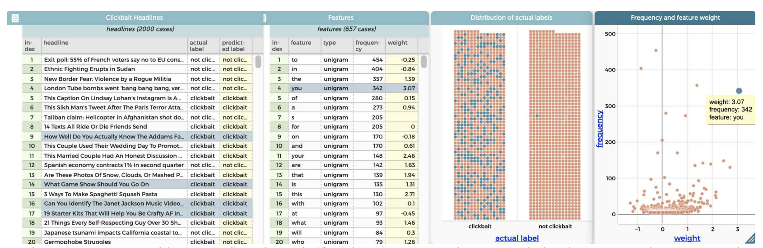
ML and AI Education
Prior research
Building on research on how students make informal predictions (Konold, 1989, Informal Conceptions of Probability)
Tatar et al. (2021), Modeling Unstructured Data: Teachers as Learners and Designers of Technology-enhanced Artificial Intelligence Curriculum
Notes:
Building on work on students modeling data with a predictive goal, recent work examines how to support students to use text to predict outcomes, like whether headlines are lcic

Slide 29
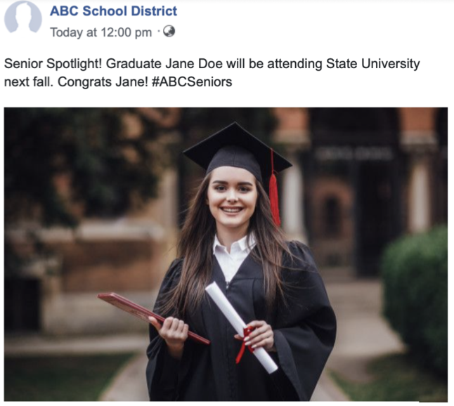
The affordances of new forms of media—and drawbacks
Prior research
Most participants in a Twitter-based network were involved in substantive conversations (Rosenberg et al., 2020, Idle chatter or compelling conversation?)
Posts on Twitter about the NGSS were very positive—much mores than posts about the CCSS (Rosenberg et al., 2020, The Next Generation Science Standards on Twitter)
Rosenberg et al. (2022), Schools' Posts on Facebook Systematically Risk Students' Privacy
Notes:
We found that around 4.9 million posts depict (show the face of) students in images. Furthermore, around 725,000 posts identify depicted students by first and last name.

Slide 30
Toward a Model

Slide 31
Back to the thesis
Toward a model
So, how should research related to data science in education progress?
Let’s play the “modeling game” with a focus on how (cf. Schwarz et al., 2009
How did the work with which I was involved work well?
How did others’ work work well?

Slide 32
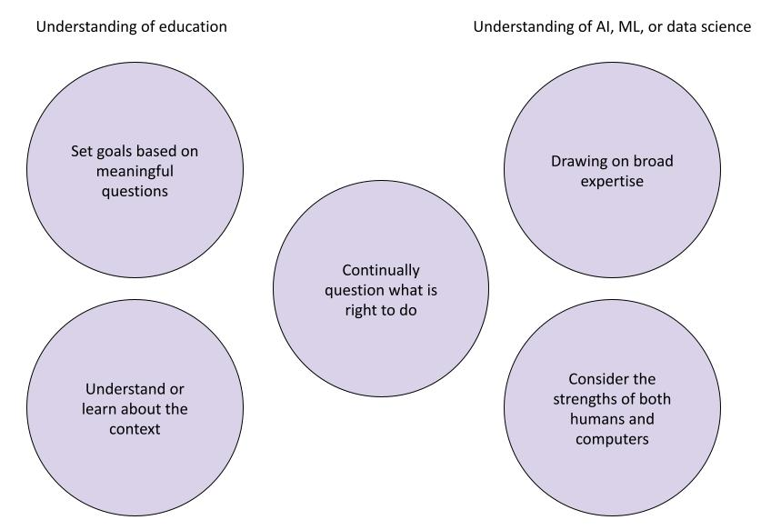
Familiarity with

Slide 33
A cooperative view of working with machines
Toward a model
There is room for humans and computers in our work, but we need to know about both to be able to answer some hard questions (Kubsch et al., 2022)
What are the tasks?
Who or what (human or computer) is doing which tasks?
Who or what should be doing which tasks?

Slide 34
AIs for humans (teachers and learners)
Toward a model
By inquiring into the epistemic functions humans and computers serve, we can draw attention to and not lose sight of the human side of this work
These may matter even more as the capabilities of AI develop (Russell, 2022)
Key questions related to AI:
Do we want use AI to control?
Or find out what teachers and learners want?

Slide 35
Why familiarity can matter
Toward a model
We can ignore, embrace, or work out for which tasks under what conditions we should use AI, ML, and data science (Kissinger et al., 2022)
If we can become more familiar, we can impact their use in varied, positive ways
Notes:
I look forward to learning with and from you about this topic and others over the upcoming days

Slide 36
Please share the questions or remarks you have!
Conclusion
Thank you very much to:
Alisa Schmid, Fitore Morina, and the the LEAD Scientific Coordination Team
LEAD members (special thanks to Christian Fischer)
LEAD Post-docs, Interns, and Students
Those hosting us here at Untermarchtal
And, the baker of the Dinkel Pur
Contact information:
Joshua Rosenberg, Ph.D.
https://joshuamrosenberg.com
jmrosenberg@utk.edu
Slides: https://tiny.utk.edu/lead-retreat
I wish to acknowledge collaborators who shaped all of the ideas I shared today, including those closely involved with the research I presented, including:
Conrad Borchers (UO), Patrick Beymer (UC), Macy Burchield (UTK), Mine Dogucu (UCI), Elizaeth Dyer (UTK), Christian Fischer (UT), Christina Krist (UIUC), Marcus Kubsch (IPN), Alex Lishinski (UTK), T.J. McKenna (BU), Vicky Phun (MSU), Joshua Reid (MTSU) Jennifer Schmidt (MSU), Sondra Stegenga (UU), Tayla Thomas (UTK), and E.J. Wagenmakers (UA)

